Slide 1
AWS – PART III
DevOps Course

Slide 2
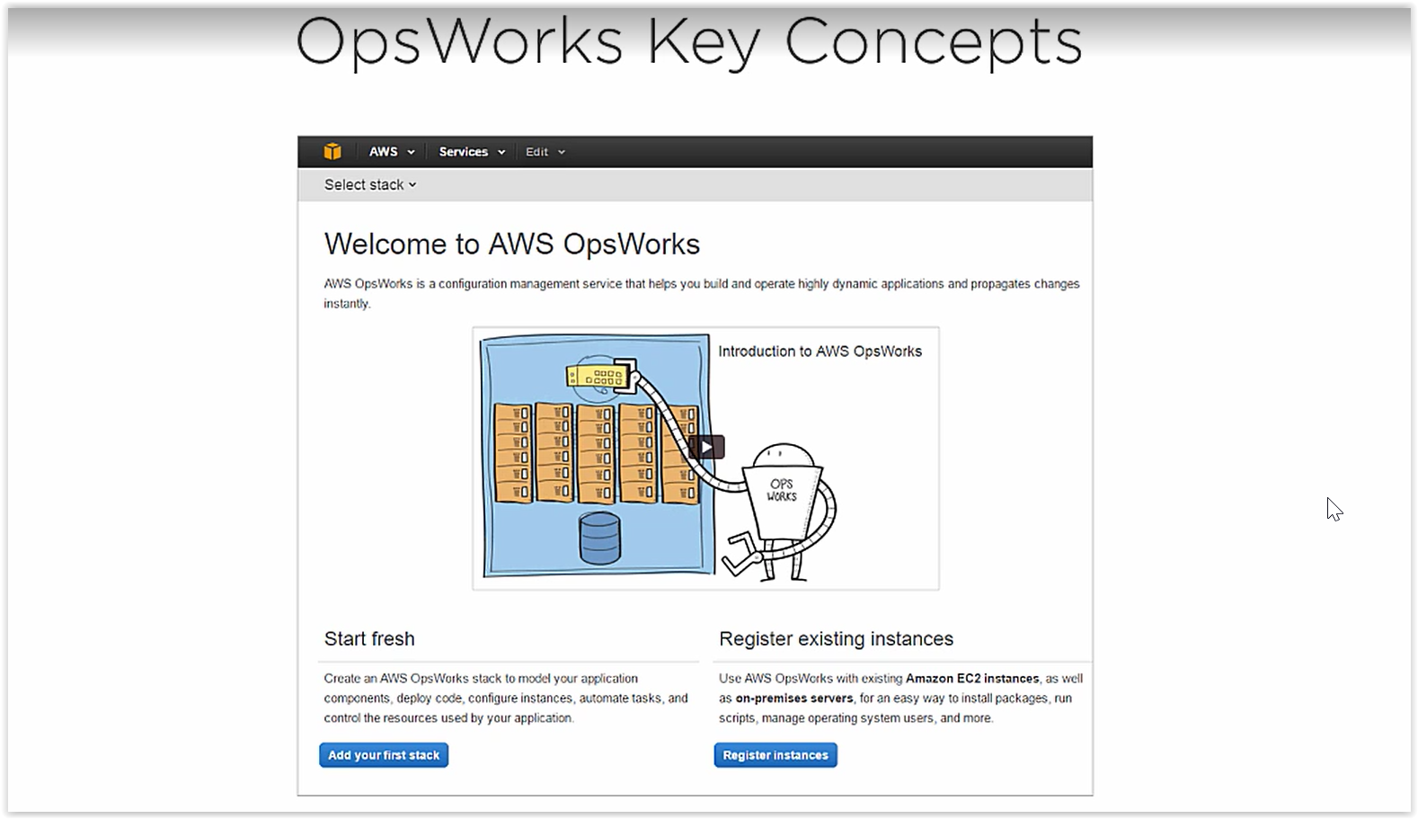
AWS OPSWORK

Slide 3
AWS OPSWORK
Support any application
Based on Chef
Support chef recipes
Config as code
Automate at scale

Slide 4
OPSWORK COMPONENTS:
Stacks: core of opswork { contains all the AWS resources}
Layers: application servers, DB servers
Load Balancer: HAPRoxy,Nginx,ELB
Recipes & lifecycle events
Instances
Apps
Load based or time based
OPSWORK Agents on each EC2 and on premise servers

Slide 5
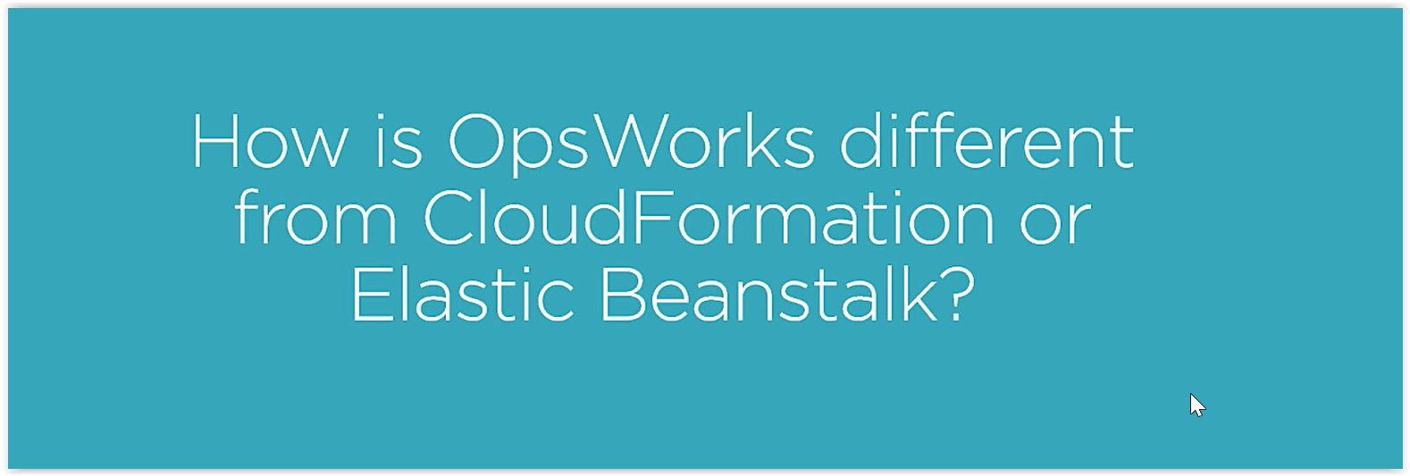

Slide 6
OPSWORK
OPSWORK is a tool that’s geared for IT administrators and OPS minded developers
Less complex than cloudformation
More customizable than Elastic Beanstalk
Elastic beanstalk is an application management platform
Cloudformation is a vast tool that work with full variety of AWS services
Opswork is simply a configuration management platform that is integrated with Chef and focus on deployment, monitoring and automation.

Slide 7
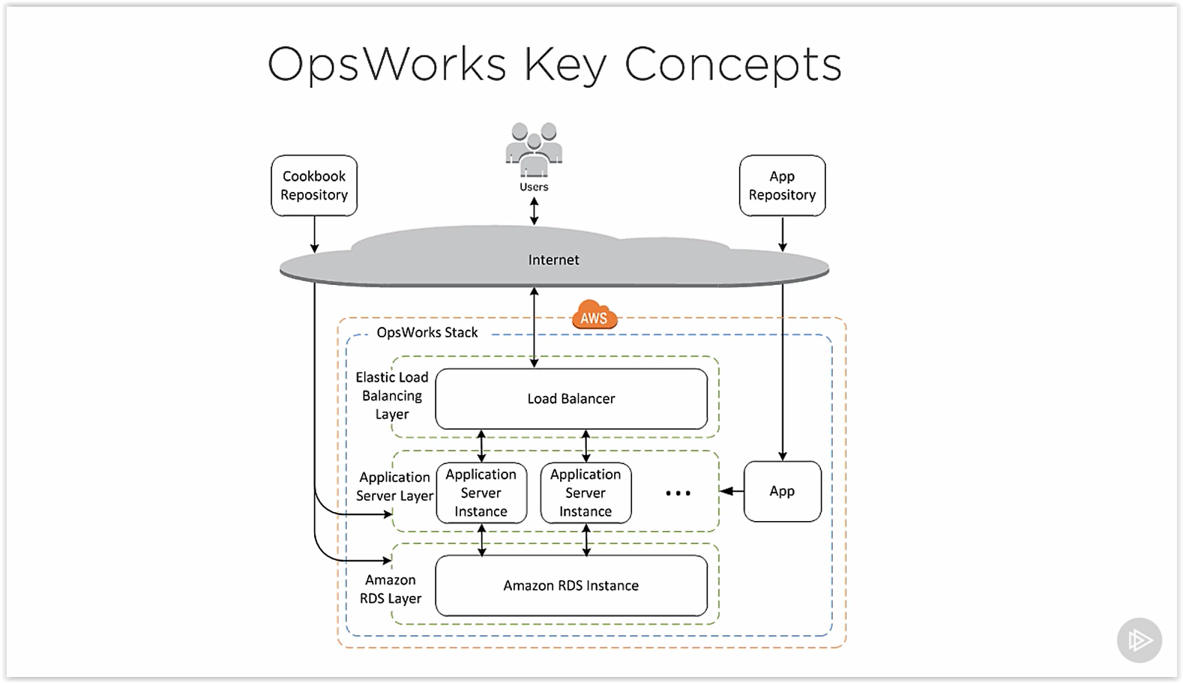
OPSWORK SCHEMA
Notes:
Inside of opswork stack we have layers
So stack have multiple layers
Layers represent a specific tier of resources

Slide 8
DEMO TIME

Slide 9
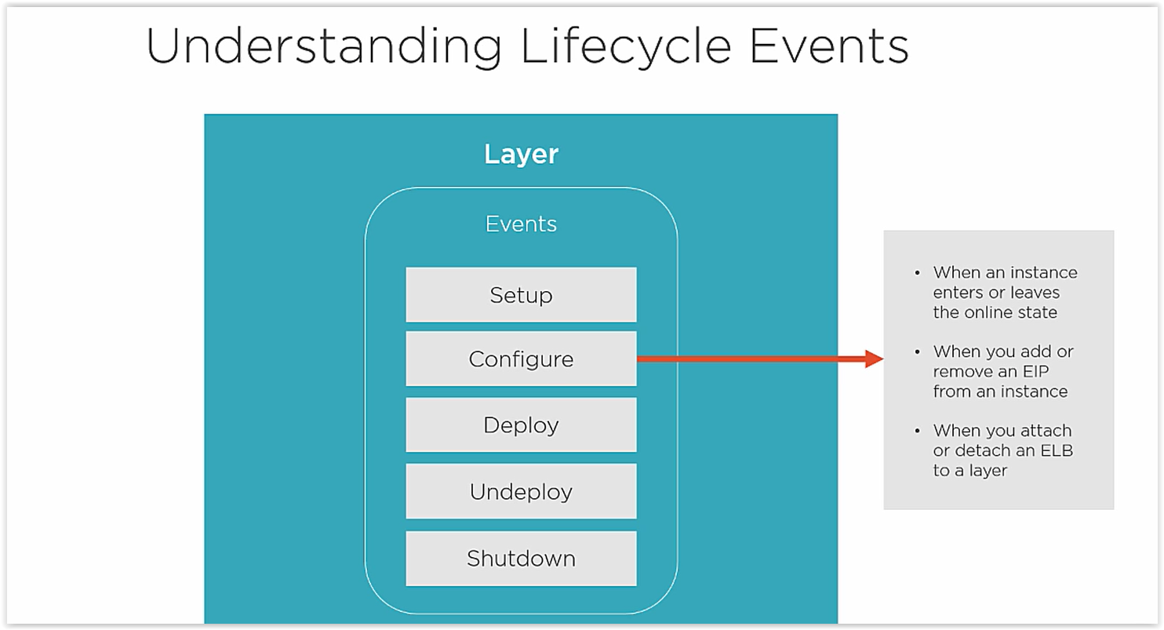
OPSWORK Life Cycle

Slide 10
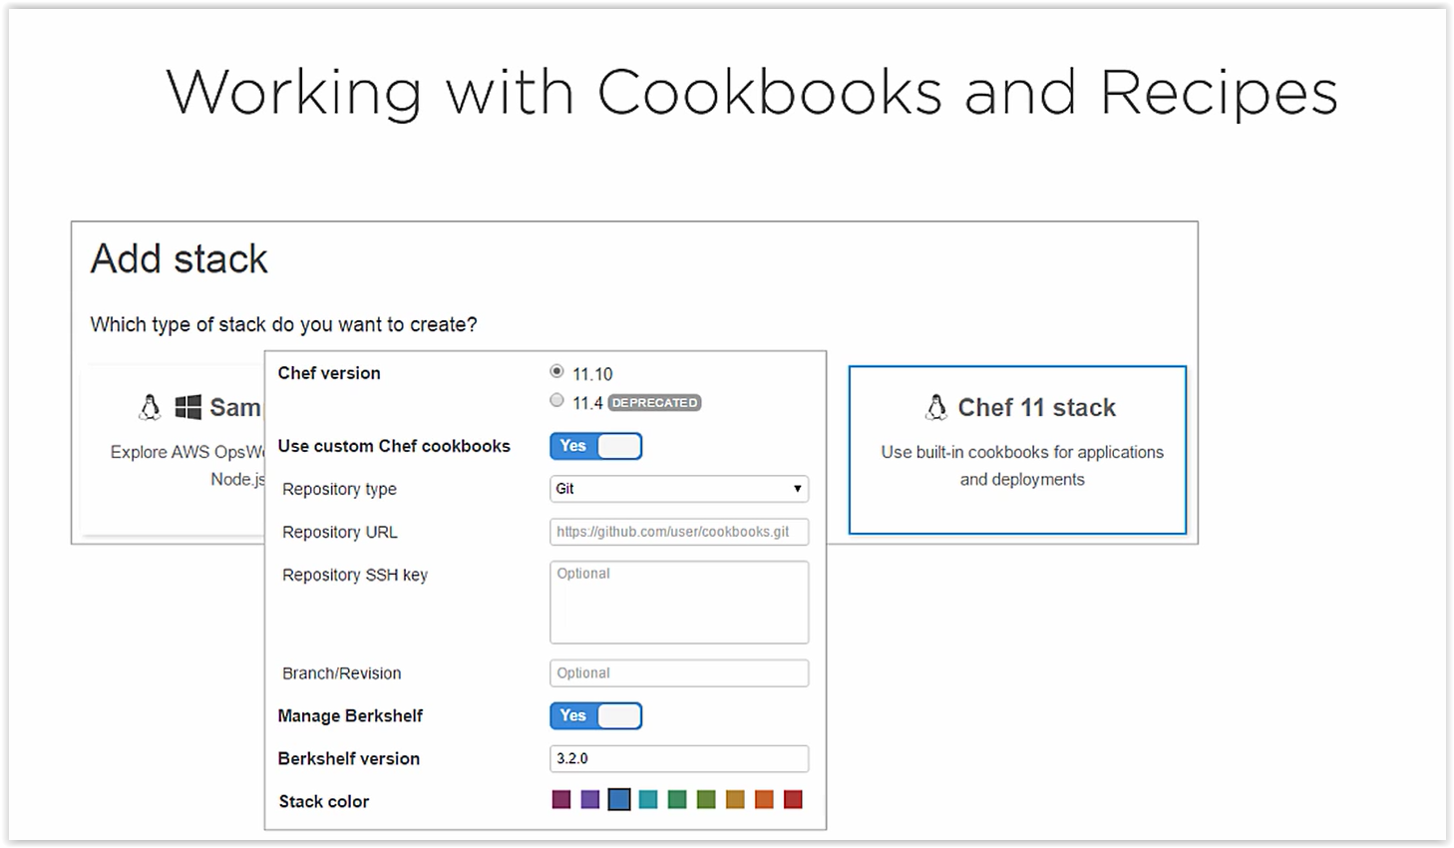
OPSWORK chef 11

Slide 11
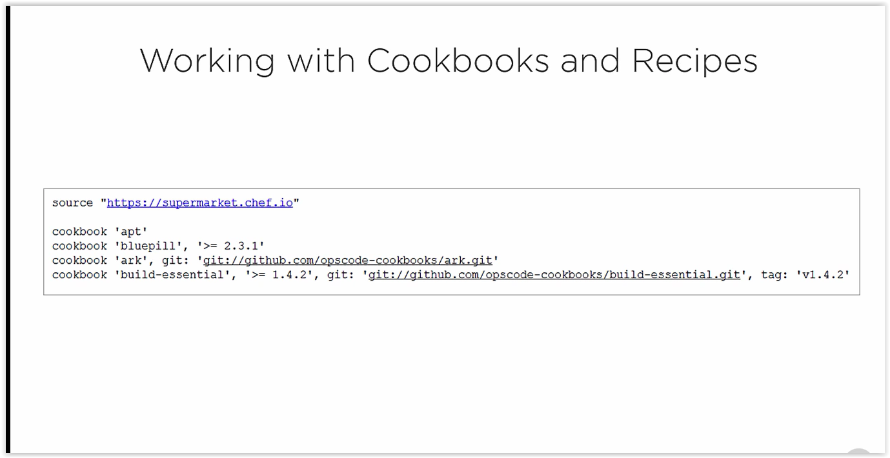
OPSWORK chef 11

Slide 12
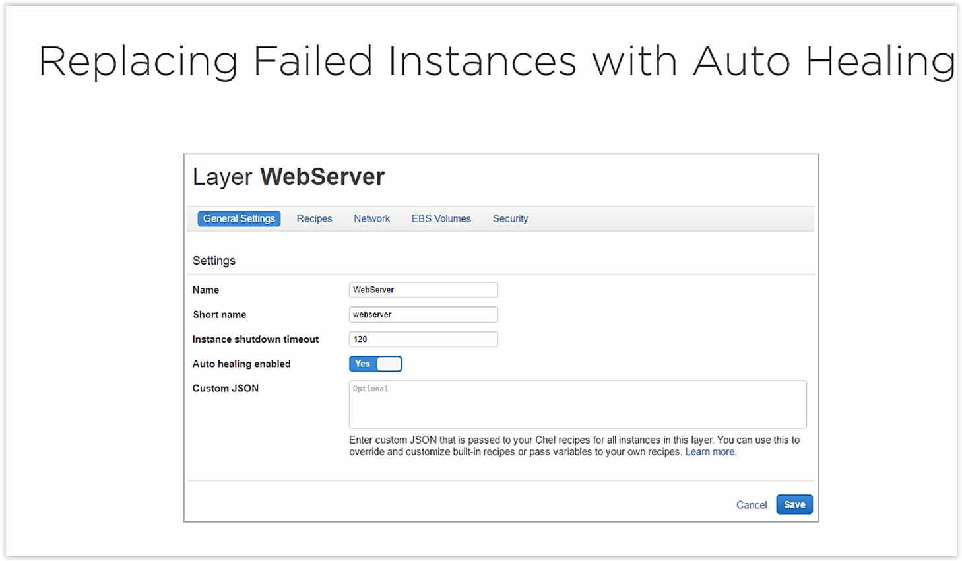
OPSWORK Auto Healing

Slide 13
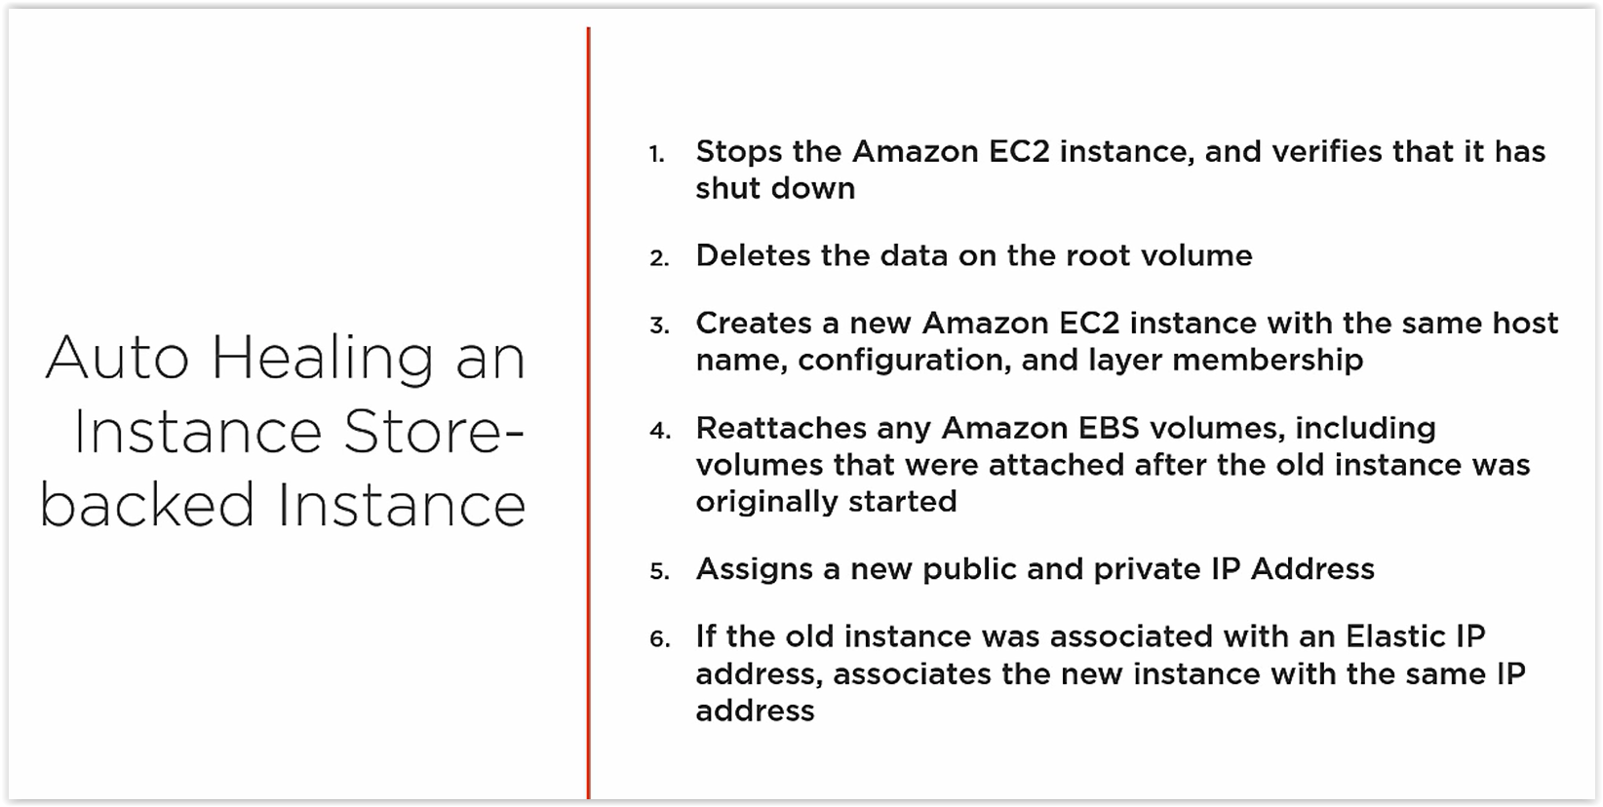
OPSWORK Auto Healing

Slide 14
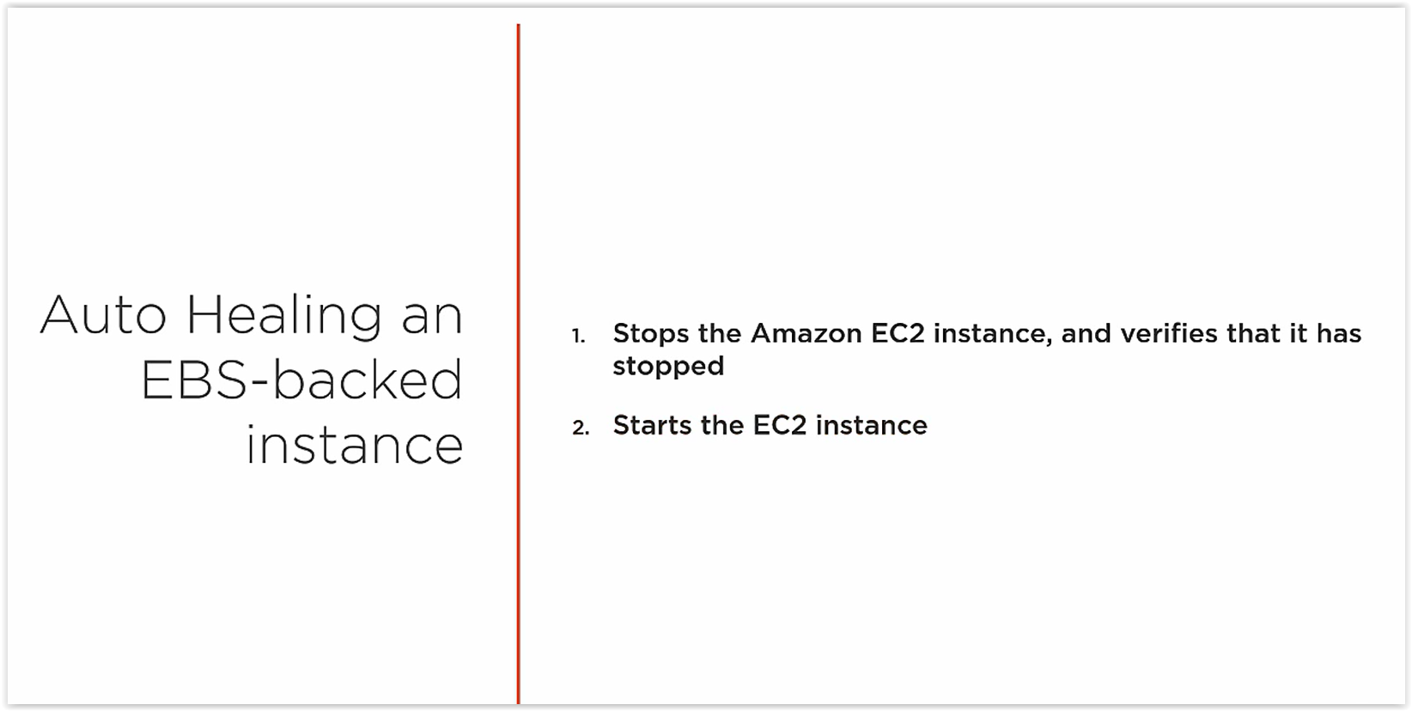
OPSWORK Auto Healing

Slide 15
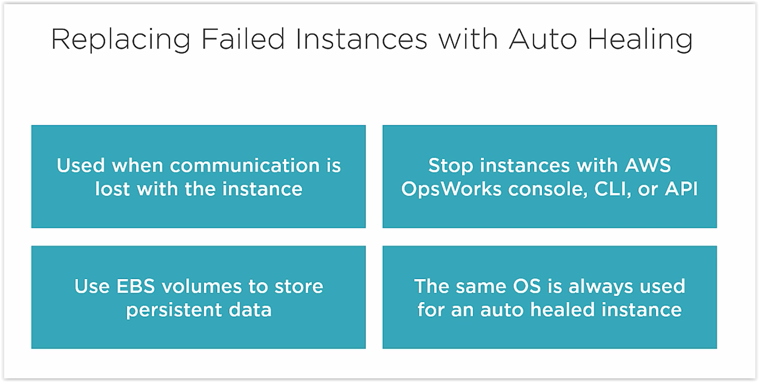
OPSWORK Auto Healing

